Slide 1

MAQAR
A Sharing Economy Platform for Professional Workspaces in Amman

Slide 2


The Amman Workspace Crisis
Booker Pains
Host Pains
70% struggle to find quiet spots monthly.
Underutilized Assets: High-rent boardrooms sitting empty for hours.
49.6% cite noise as their #1 barrier.
Manual Friction: Relying on WhatsApp and phone calls for scheduling.
Unanswered phone calls and "blind searches" lead to wasted productivity.
Lost revenue due to disorganized booking methods.

Slide 3
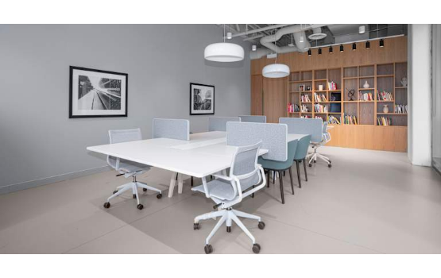
Digital Workspace Platform
Maqar transforms "dead space" into productive assets. We provide a way for professionals with suitable rooms to increase productivity.
•
Map-First Discovery: Instant visibility into local hubs like Mecca Street, Abdali and Khalda.
•
Instant Booking: 30-minute increments with live availability times and instant confirmation.
•
Verified Specs: Privacy guarantees, professional tools, verified room details.

Slide 4



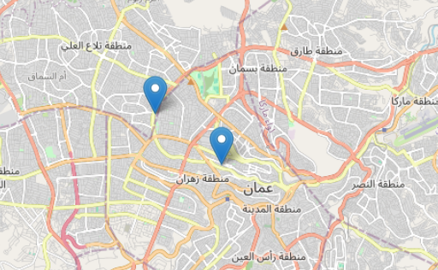
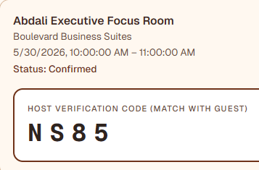
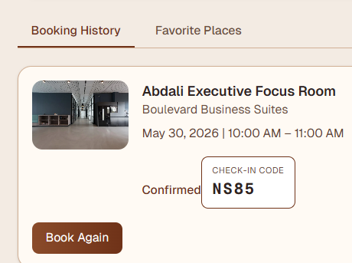
Prototype Key Features
Discovery
Host Tools
User Sync
Interactive Map With Filters & Real Availability Times.
Occupancy Chains & 4-Digit Check-in Validation.
Booking History, Favorites, & Real-time Delay Alerts.

Slide 5
Let’s Take a Closer Look
At Our Prototype !

Slide 6
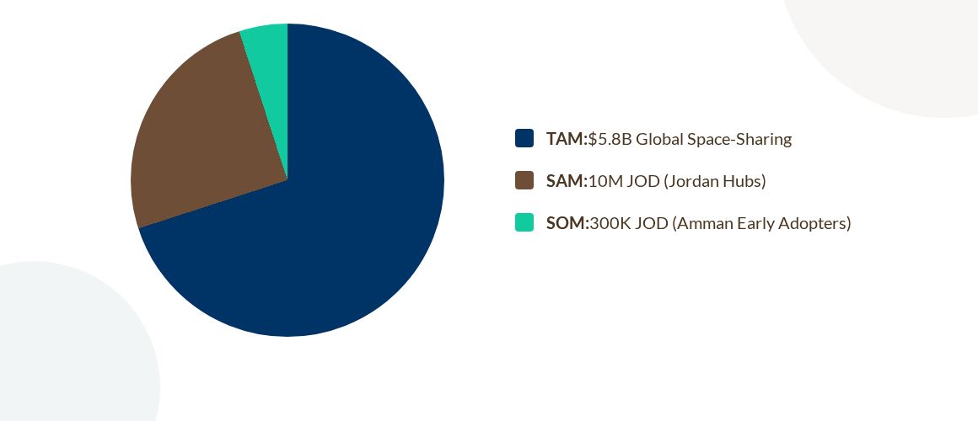
Market Size Opportunity
for SOM we generate an average of 15% which totals 45k.

Slide 7
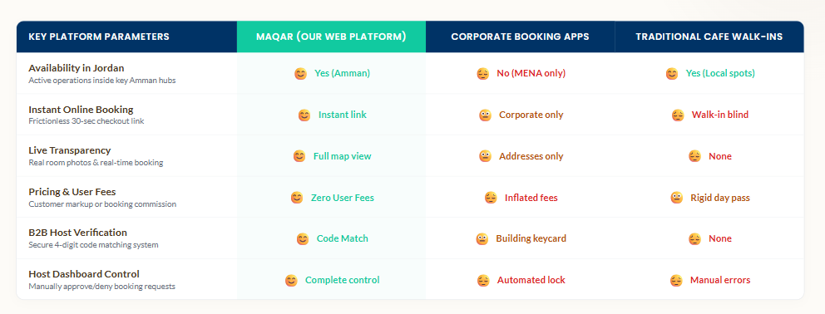
Competitive Benchmarking

Slide 8
Our Unique Competitive Edge
Why Maqar Wins
Feasible & Validated Platform
Security-First: 4-digit verification codes ensure trusted access without hardware scanners.
A Win-Win Revenue Engine: Giving positives to all sides without presenting extra costs or risks.
Zero Markup: Customers pay standard rates; we monetize via a host commission based on successful bookings.

Slide 9





A Win-Win Revenue Engine
For Bookers
For Hosts
No Risk
Guaranteed focused environment, reliable Wi-Fi, and professional settings without any extra costs.
Turn unused boardrooms into revenue. Zero risk, managed booking system, and increased business visibility.
No upfront costs for hosts. Users pay only for what they use. Security-first verification for peace of mind.

Slide 10
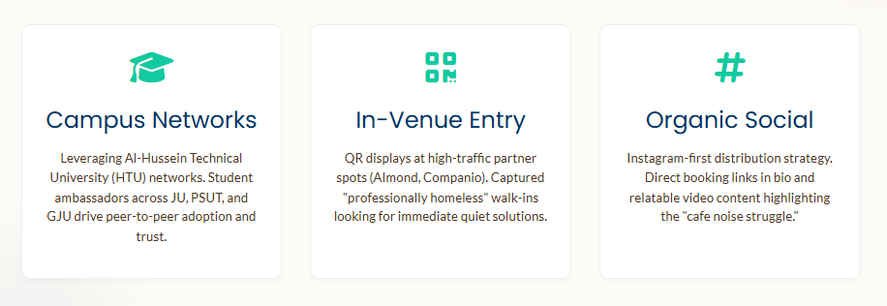
Multi-Channel Customer Engagement

Slide 11
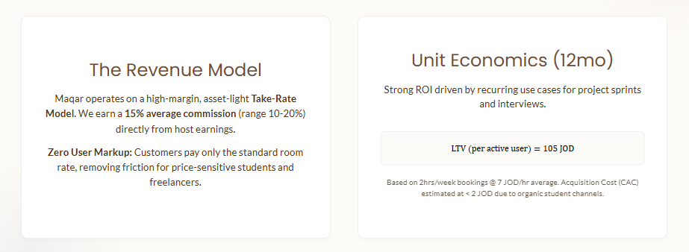
Sustainable Marketplace Economics

Slide 12
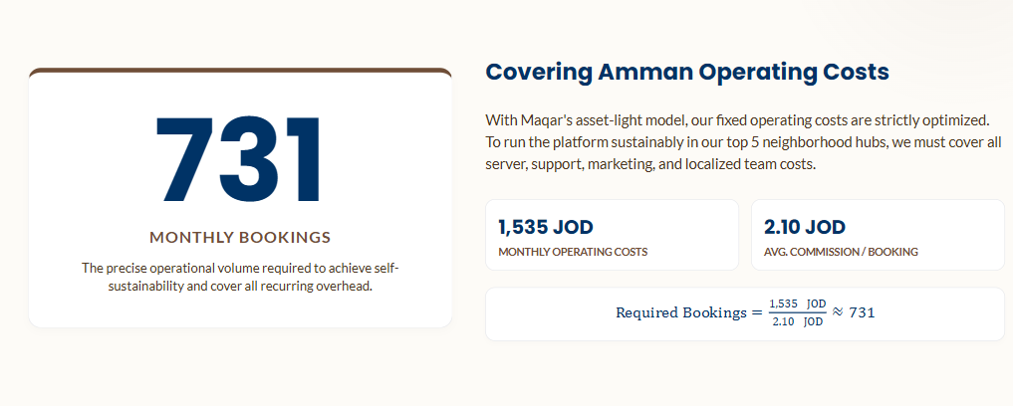
Financial Strategy: Break-even Point

Slide 13
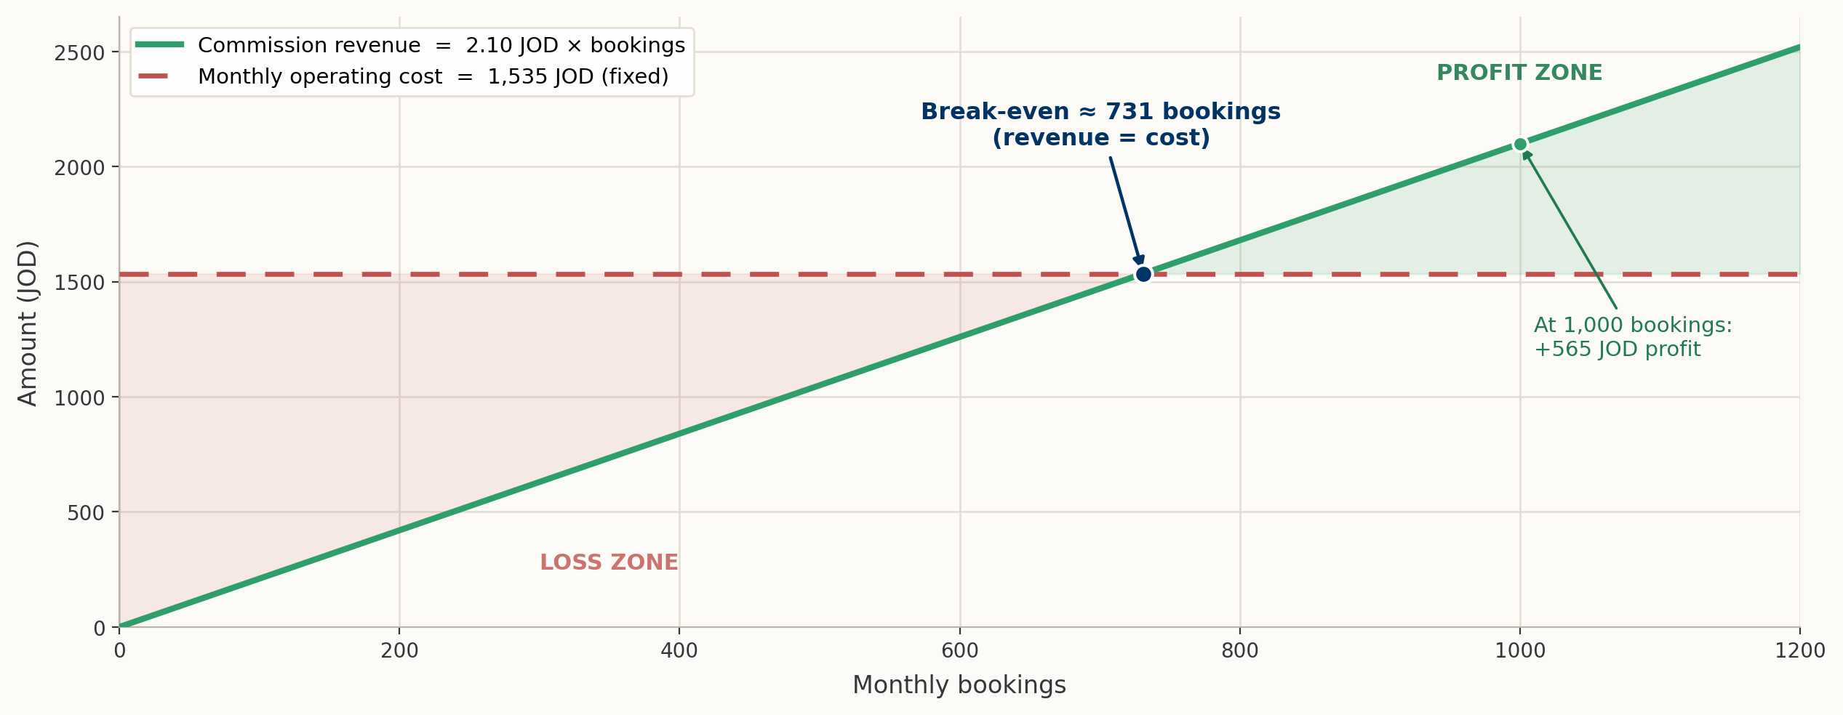
Financial Strategy: Break-even Graph

Slide 14
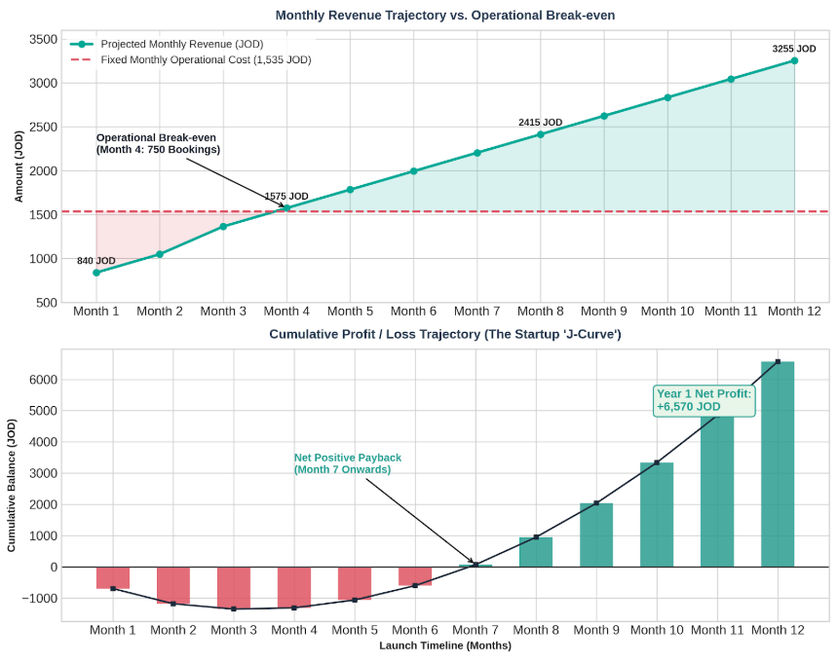
Financial Strategy: Income Statement
While the first three months require a modest capital burn to onboard hosts and build student awareness, Month 4 is where our marketplace engine achieves operational break-even by exceeding 731 bookings. From this month onward, our fixed overhead stays locked at 1,535 JOD while our marketplace commissions grow exponentially.

Slide 15
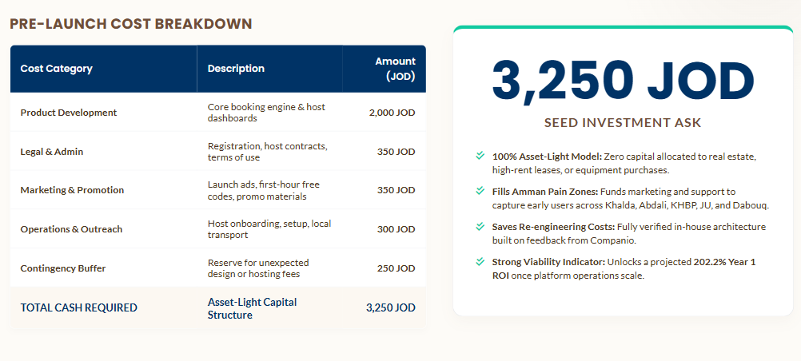
Pre-Launch Budget & Investor Ask

Slide 16
Future Scaling Roadmap
Phase 1
Phase 2
Phase 3
Vision
Pilot launch in 5 high-density Amman hubs.
Full scale across major Jordan cities (Irbid, Zarqa).
Regional expansion to Saudi Arabia & UAE.
Integration with B2B enterprise suites.

Slide 17
Thank You
Saif Ibrahim • Khaled Al-Madhoun • Yousef Byouk • Tamer Ali

